Slide 1
Welcome Fall mtg. Oct. 15,2021
PSSC 2021-22
Claudine Dionne
Christy Dingee
Beth Boyd
Lisa Kitchen
Christina Young
Richard Williams
No District Education Rep. at this time.

Slide 2
Agenda
Call to Order:
Approval of the Agenda:
Approval of the Minutes from June 10 - 2021
Business related to first meeting: Approval of the Minutes from Previous Meeting: June 10, 2021
Business Related to the First Meeting
Introduction – virtual round table
Role of PSSC & PSSC cycle
Declaration form
Nomination of Chair, Vice Chair and Secretary –
Principal’s Report
Enrollement and staff
School safety
School Improvement Plan focus
Fundraising project and goal
New Business:
School Improvement Plan (SIP) & PLWEP positive learning working plan
Sports -
Dates for meeting for the year
Correspondence:
Closing Comments:

Slide 3
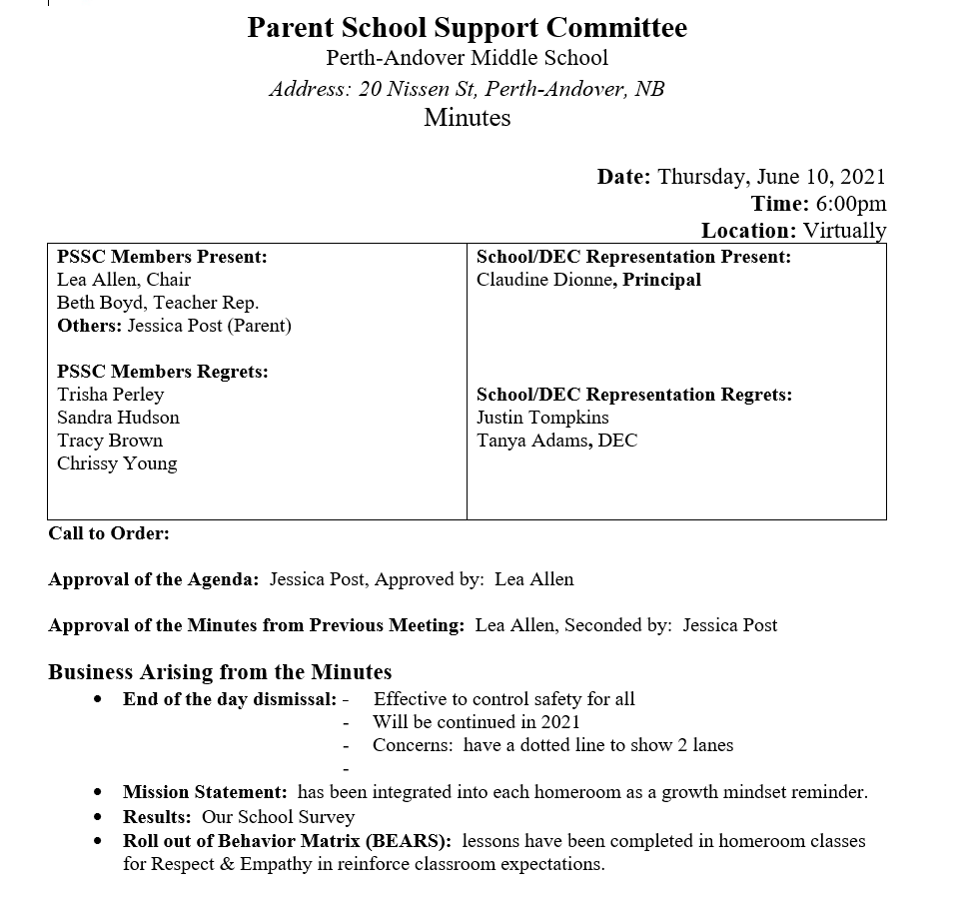

Slide 4
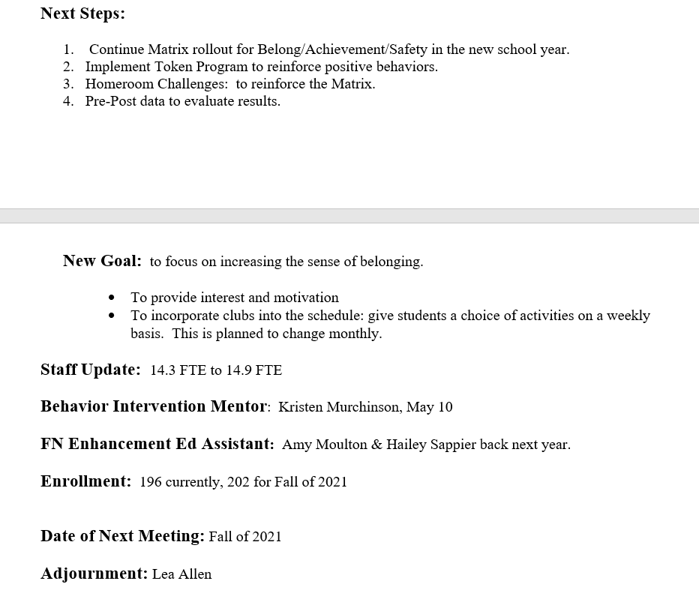

Slide 7
JUNE
DECEMBER
FEBRUARY
APRIL

Slide 8
Meeting dates
December
February
April
June

Slide 9
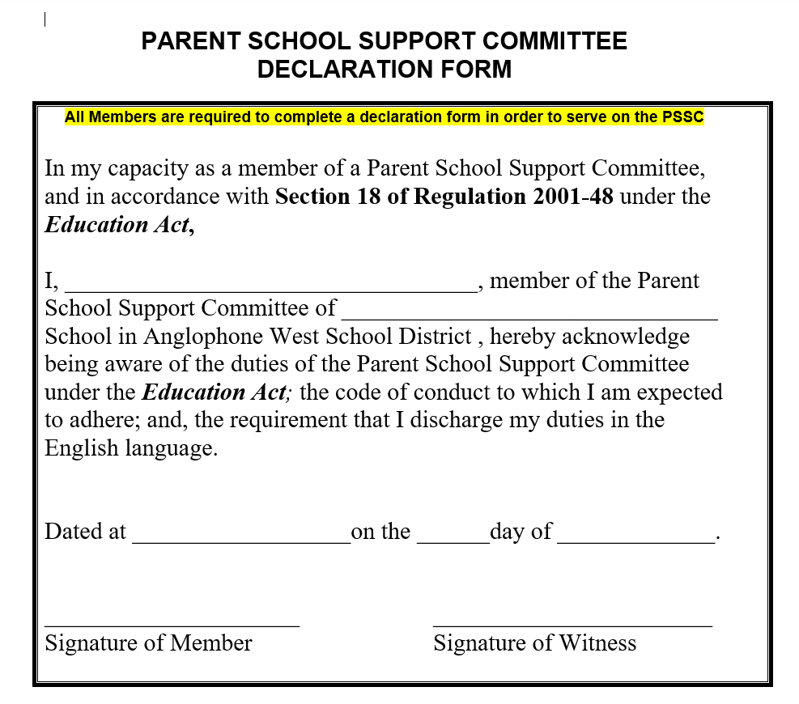

Slide 10
Election of officers
Chair
Vice Chair
Secretary

Slide 11
Principal’s report – 205 students

Slide 12
PAMS
10 Classes
Teachers
Educational Assistants
16 Full time
Including
FT guidance counsellor
3 grade 6
3 grade 7
4 grade 8
6 District Educational Assistants
2 First National Academic Support
Jordan’s Principle Support worker
Behavior interventionist
2 custodians
1 administration assistant

Slide 13
At PAMS, we create a positive learning environment that promotes a sense of belonging and resiliency for ALL.

Slide 14
School safety / improvements
Paved access to field
After school pick up improved
Request to village to examine a crosswalk at fort road and Nissen

Slide 15
Good Morning Claudine,
In response to the request for a crosswalk at Fort road and Nissen street, there has been no decision made. The municipality was told 5 years ago that DTI did not want a cross walk there because of the three lanes of traffic and visibility issues which may arise if a bus were in a turn lane and a child was walking across the road, the vehicle in the passing lane may not see the child and could have a negative result.
That being said, Council has a strategic planning meeting the end of October and will be covering the topic of crosswalks in the community.
Wish I had better news. Thanks.
Kind Regards,
Justine Waldeck
Assistant CAO

Slide 16
School improvement Plan GOALS
1. To increase responsible decision in the classroom by rolling out the BEARS behavior matrix.
2. To improve standards based data tracking in language arts and math.

Slide 17
1. To increase responsible decision in the classroom making by rolling out of behavior matrix.
Indicators of success
Participation in class
Participation in school activities
Greater Academic success
Improved results on student perception survey – Dec. 2021
Strategies
Lessons on each component delivered each week
Pre-post surveys will determine success of delivery
PBIS tokens will be used to reinforce success on following component.
School wide virtual celebrations
Homeroom challenges and school wide activities follow the matrix component

Slide 18
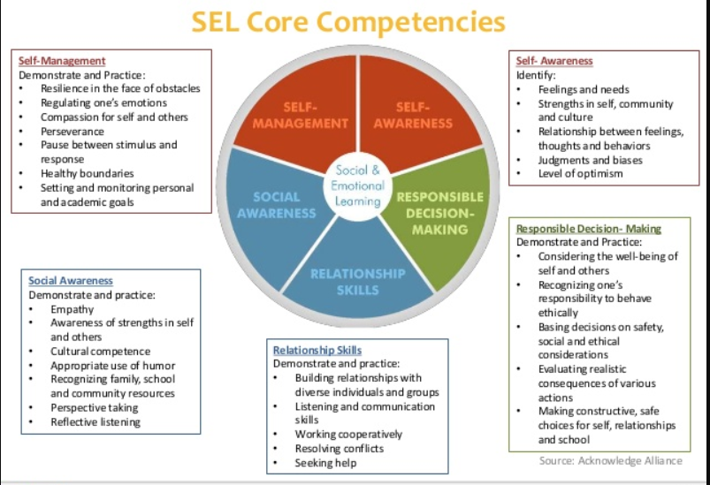

Slide 20
2. To improve standards based data tracking in language arts and math.
Indicators of success
Students are aware of progress and can share next steps
More specific report card comments
Just in time data is available for interventions
Strategies
Professional learning for teachers
Bi-weekly committee meetings to share success and challenges
Increased conferencing with students

Slide 21
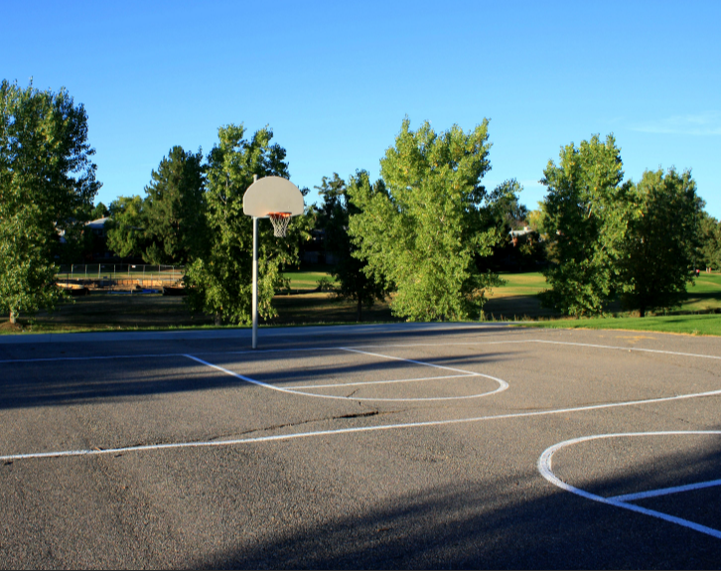
Fundraising Goal

Slide 22
Fundraising 2021 -
Nov. 1 – Nov. 15
6 inch pots - $12
$4.75 profit per pot

Slide 23
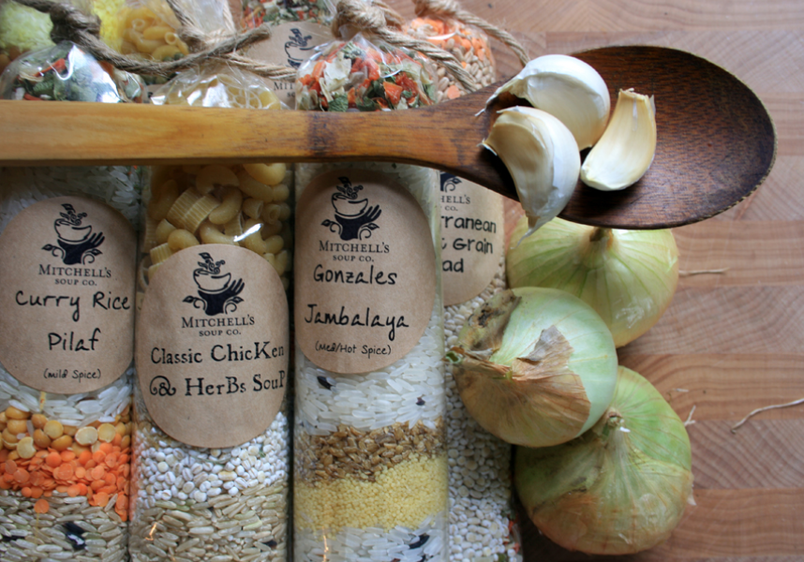
Fundraising 2020
December?
February?
Nov. 2 – Nov. 13
6 inch pots - $10
3.20 profit per pot

Slide 24
School donations / applications
Elks – funds to build washer toss games for students (collaborate with SVHS)
Wellness Grant – for cooking club
Elks – donation for books
Legion – donation for books
Pending
Rotary – funds for books
PAFD – funds for playground

Slide 25
Canada Feed the Children 2 new microwaves toaster small Appliances green House and garden supplies Thanksgiving and Christmas lunch Meal tickets

Slide 26
Oct. 22 – Orange Shirt Day
Wear orange
Read Aloud in class
Sacred Fire
Smudging

Slide 27
Safe School Week – Oct. 18 - 22
Monday | Tuesday | Wednesday | Thursday | Friday
PDCP -Social/ Emotional/ Physical safety | Club day | Internet Safety / School evacuation drill/ presentation / Bus drill | Lockdown drill/ Orange shirt day | Fire drill

Slide 28
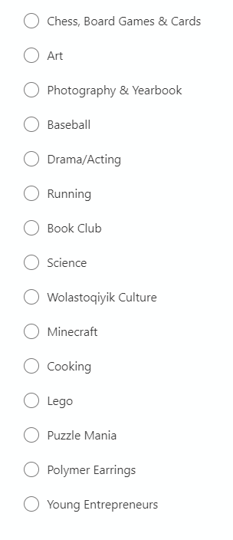
Club Day

